Slide 1
CS 230 Game Implementation Techniques
Week 5 Lecture
Instructor
Doug Schilling
dschilling@digipen.edu
x5066
Office Hours
Mon 12:00pm – 1:00pm, Wed 10:30am – 11:20am, or by appointment at digipen.as.me/dschilling
Project 3

Slide 2
Project 3
IMPORTANT NOTES

Slide 3
Project 3
Test Your Work!
The Matrix2D functions are a primary focus
Some functions are not called in Project 3
It is your responsibility to test every function!
HINT: Every function will be graded using automated unit tests

Slide 4
Project 3
Warning!
Your implementation must also support duplicate parameters
For example, both of the following must return valid results:
Matrix2D m;
Matrix2DRotDeg(&m, 45.0f);
Matrix2DConcat(&m, &m, &m);
Matrix2D m0, m1, m2;
Matrix2DRotDeg(&m1, 45.0f);
Matrix2DRotDeg(&m2, 90.0f);
Matrix2DConcat(&m0, &m1, &m2);

Slide 5
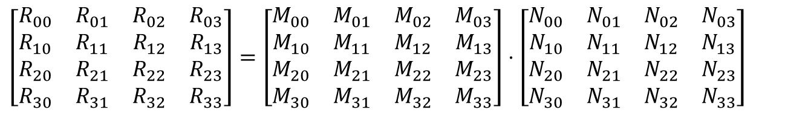

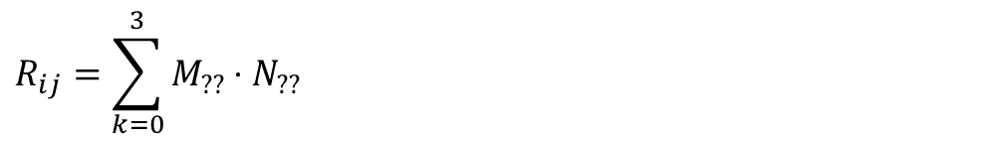
Concatenation of Matrices
To calculate the resultant matrix:
To calculate a single cell in the resultant matrix
$$R=M⋅N$$
$$\left[\begin{matrix}R_{00} & R_{01} & R_{02} & R_{03} \\ R_{10} & R_{11} & R_{12} & R_{13} \\ R_{20} & R_{21} & R_{22} & R_{23} \\ R_{30} & R_{31} & R_{32} & R_{33}\end{matrix}\right]=\left[\begin{matrix}M_{00} & M_{01} & M_{02} & M_{03} \\ M_{10} & M_{11} & M_{12} & M_{13} \\ M_{20} & M_{21} & M_{22} & M_{23} \\ M_{30} & M_{31} & M_{32} & M_{33}\end{matrix}\right]⋅\left[\begin{matrix}N_{00} & N_{01} & N_{02} & N_{03} \\ N_{10} & N_{11} & N_{12} & N_{13} \\ N_{20} & N_{21} & N_{22} & N_{23} \\ N_{30} & N_{31} & N_{32} & N_{33}\end{matrix}\right]$$
$R_{01}=M_{00}⋅N_{01}+M_{01}⋅N_{11}+M_{02}⋅N_{21}$ $+M_{03}⋅N_{31}$
$$R_{ij}=\sum_{k=0}^{3}{M_{??}⋅N_{??}}$$

Slide 6
Project 3
Implementation Suggestions

Slide 7
Step 0
Unzip the Project 3 materials into a clean folder
Add and commit the files to version control
SVN or GIT recommended
Do this before opening the project in Visual Studio

Slide 8
Step 1
Integrate code from Project 2 into Project 3
Create new .c modules and add stub functions
Include comments from the header file or you may miss important requirements (see “NOTES” and “HINTS”)
Add temporary return values and unreferenced parameter macros as necessary to compile the code
Writing new code while you are unable to compile and test can be very unproductive
Add and commit the files to version control
Hint: Right-click on “Source” and click “TortoiseSVN/Add”

Slide 9
Step 2
Matrix2D.c
Implement the Matrix2DIdentity function
Implement the Matrix2DTranslate, Scale, and Rot* functions
Implement the Matrix2DConcat function
Implement the remaining functions at any time
Make sure to test every single function!
Every incorrect function will deduct points from the project grade
(-2.5% to -5% per function)

Slide 10
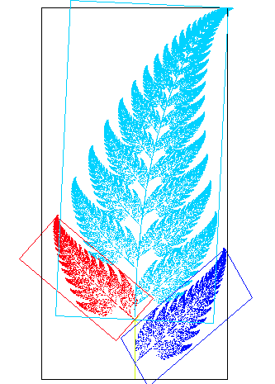
Step 3
Transform.c
Implement TransformGetMatrix
Verify that the transformation matrix is calculated correctly
Create a simple test case that you can compute in your head or on a calculator. For example:
Vector: (1, 2)
Scale: (3, 4)
Rotate: 90°
Translate: (5, 6)
Why use these different numbers?

Slide 11

Step 4
Sprite.c
Modify SpriteRender to correctly use the new function, TransformGetMatrix
Verify that both colored and textured meshes are still drawn correctly
Do not implement sprite text until these changes are working correctly!
[Pro Tip: Commit your changes to version control]

Slide 12
Step 5
Level1Scene.c
Change the Planet Entity from PlanetJump.txt to PlanetBounce.txt
Implement Level1SceneBounceController
Pass the Planet Entity into the new controller
Note: You may need to temporarily comment out the existing controller for now
Verify that the Planet spawns in the correct location and bounces around within an invisible “box”
[Pro Tip: Commit your changes to version control]

Slide 13

Step 6
Animation.c
Implement the Create, Read, and Free functions
The Play, Update and IsDone functions aren’t needed yet
Leave these as stub functions, using UNREFERENCED_PARAMETER and “return false;” to address any errors

Slide 14
Step 7
Level1Scene.c
Implement the code to create the new Monkey Entity
Use Level1SceneMovementController to move the Monkey
Verify that the Monkey moves correctly
[Pro Tip: Commit your changes to version control]

Slide 15
Step 8
Animation.c
Implement the Play, Update and IsDone functions

Slide 16
Step 8 - Animations (Play)
Playing Animations
Both simple and sequenced

Slide 17
Step 8 - Animations (Update)
Updating Animations
Recommend creating two functions
AnimationUpdate()
AnimationAdvanceFrame()
The second function should be made private (declared “static”)

Slide 18
Step 9
Level1Scene.c
Implement the Level1SceneSetMonkeyState function
Update Level1SceneMovementController to control the Monkey’s current state
Implement any remaining animation functionality
E.G. Correctly load and unload all sprite sources
Verify that the Monkey continues to move properly
Verify that the Monkey animates properly in all states
Idle animation only when stationary
Walk animation only when walking left/right
Jump animation only when moving in the air

Slide 19
Step 10
Level1Scene.c
Implement Level1SceneIsColliding
Implement logic to detect when the two objects are colliding
Update numLives appropriately
[Pro Tip: Commit your changes to version control]

Slide 20

Step 11
Sprite.c
Implement SpriteSetText
Modify SpriteRender to now display sprite text

Slide 21
Step 12
Level1Scene.c
Implement the LivesText Entity, including all supporting assets, variables, and clean-up code
Add code to update the livesBuffer when numLives changes
Verify that the text changes each time the Monkey “collides” with the Planet
[Pro Tip: Commit your changes to version control]

Slide 22
Step 13
CheatSystem.c
Implemented the CheatSystem functionality
Main.c
Add CheatSystem to the engine
Scene.c
Remove the existing, copy-and-paste cheat code

Slide 23
Step 14
Commit all changes to version control

Slide 24
Step 15
Reread all of the instructions
Check off every step that has been completed and verified
Missed steps are a common source of errors
Check your submission using the recommended steps
An extra 3 minutes can help avoid a -25% penalty

Slide 25
Questions?

